Slide 1
UCU-LSIS-Unison Staff Governors’ Conference 3 December 2012 Public Value Statements

Slide 2
A bit about us …..
Carlisle College:
Is situated in the North West of England, just south of the Scottish Border
Is a general FE college serving a community of learners which is both urban and deeply rural
Has a turnover of about £11m

Slide 3
Public Value Statement – Why?
The English Colleges’ Foundation Code of Governance states:
“1.8 – The governing body is accountable to its learners, to the wider community it serves and to other stakeholders…. It should agree and maintain a public value statement that describes how the college seeks to add value to the social, economic and physical well-being of the community it serves.”
Colleges are exempt charities – they have a duty to demonstrate how they provide a benefit to the public in return for their charitable status.

Slide 4
What is PVS?
It is a statement which defines the value of an educational initiative to those who do not directly benefit from that initiative.
The college/PVS
Policy makers/funding bodies
community
employers

Slide 5
PVS – An explanation
Mark H Moore, Hauser Professor on Non-profit Organisations at Harvard, ‘Creating Public Value: Strategic Management in Government 1995
Private Sector – companies offer products for sale to maximise profits, where profits = value for shareholders
Non-profit sector – organisations offer services (e.g. education) for the benefit of the community, which may be funded in whole or part by the public purse. Therefore value to stakeholders = demonstration of public benefit

Slide 6
Accountability
The PVS should allow the college to demonstrate both vertical and horizontal accountability
The college/PVS
Policy makers/funding bodies
community
employers

Slide 7
Where does it fit?
Needs to be readily accessible
Regularly reviewed
Linked to vision, mission and key strategic aims
Needs to be easily understood
Carlisle Corporation decided that the most appropriate place for it was just below the mission statement in the strategic plan.
College values
PVS
Mission

Slide 8
Carlisle’s PVS – our process
Options drafted and put of for consultation with stakeholders
Discussed by the Board at a Strategic Forum
Research undertaken by Clerk
Final wording adopted by the Board as part of the Strategic Plan

Slide 9
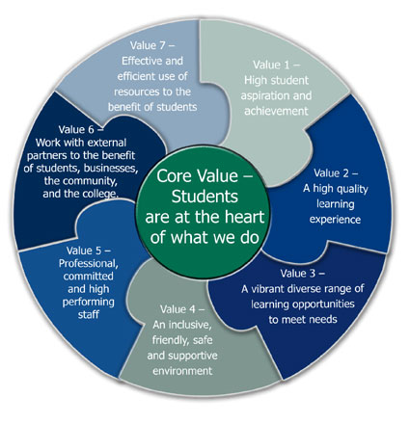
Carlisle – Our PVS
Mission Statement
To be recognised as an outstanding and inclusive College providing life changing skills and experiences
Public Value Statement
Carlisle College contributes to the social, economic, physical and cultural well-being of the community it serves through the delivery of education, training and learning to support the development of individuals and businesses

Slide 10
Further Reading
AoC Governance Briefing 07/12:
AoC Paper - Colleges Engagement with Communities
AoC Governance Portfolio Group - Guidance to Colleges on a ‘Public Value Statement’
Charity Commission Guidance on Reporting Public Benefit (http:charity-comission.gov.uk/Charity_requirements_guidance/Charity_essentials/Public_benefit/pbeduc.aspx)

